Slide 1

EU Air Traffic Analysis
Ironhack data analytics mid-bootcamp project
Presented By: Asli Veenstra
Last updated: January 5th, 2022
https://github.com/aslivns
IH-2022

Slide 2

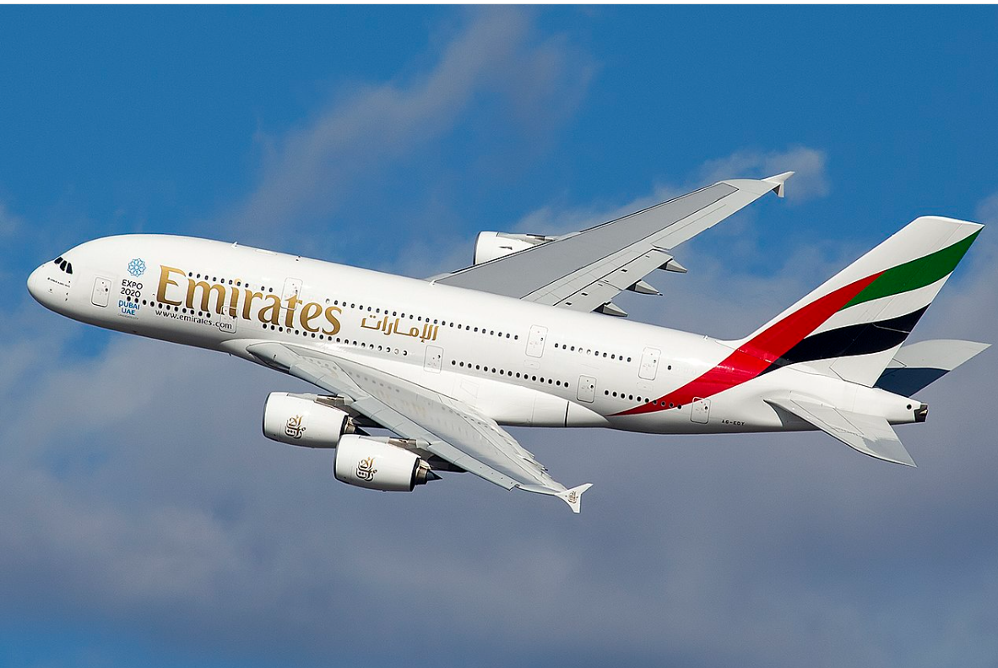
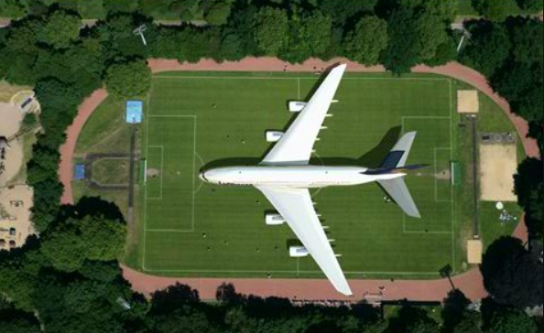
Superjumbo, double deck, capacity for 550 pax
Project started in mid-1988
25 Oct 2007 with flight number SQ380 between Singapore and Sydney by Singapore Airlines
On 16 Dec 2021, Emirates received its 123rd A380, which was the 251st and last delivered by Airbus. Retirement of its A380s is planned to be started after 2035

Slide 3

This analysis is about EU air traffic recovery after Covid-19 pandemic
Dataset includes records of airports in 27 EU countries
UK is not included in this analysis (before 2020)
Measurement is arrival-departure flights by each airport, which causes duplications
Ex: Passengers flying from Amsterdam to Athens are counted in AMS airport as ‘departure’ and after their landing they are counted in ATH airport as ‘arrival’

Slide 4
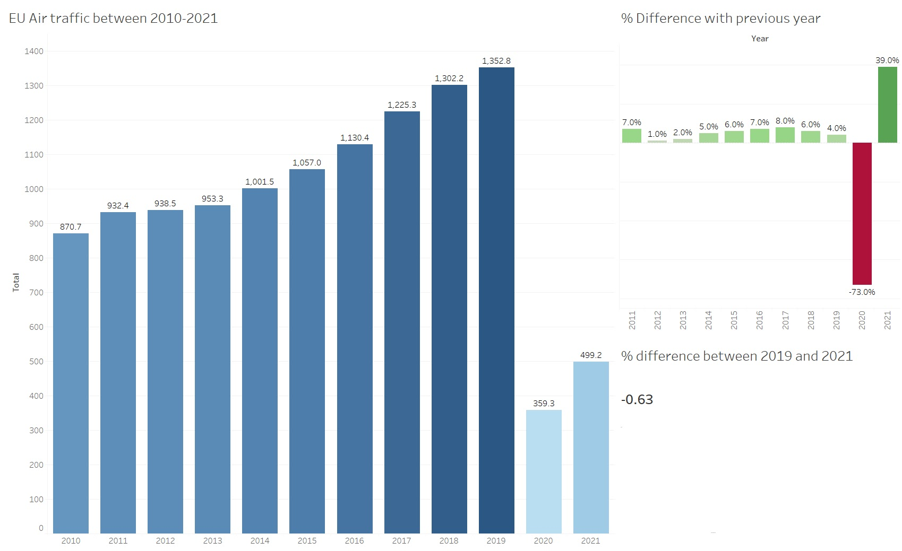

Slide 5
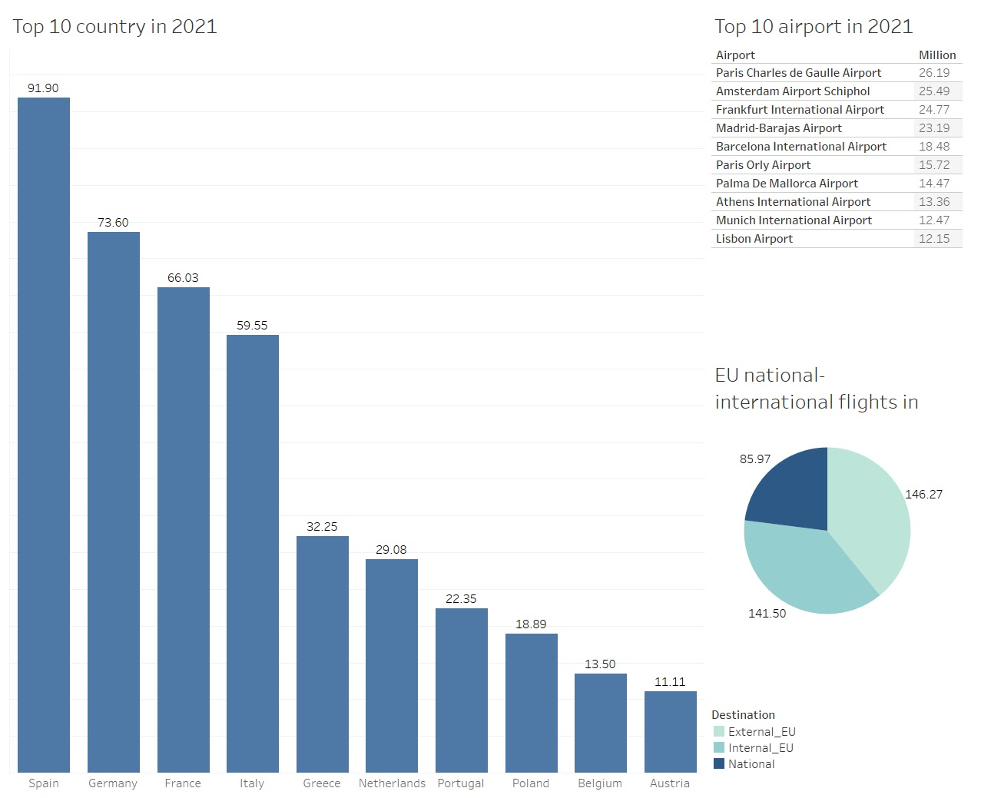

Slide 6
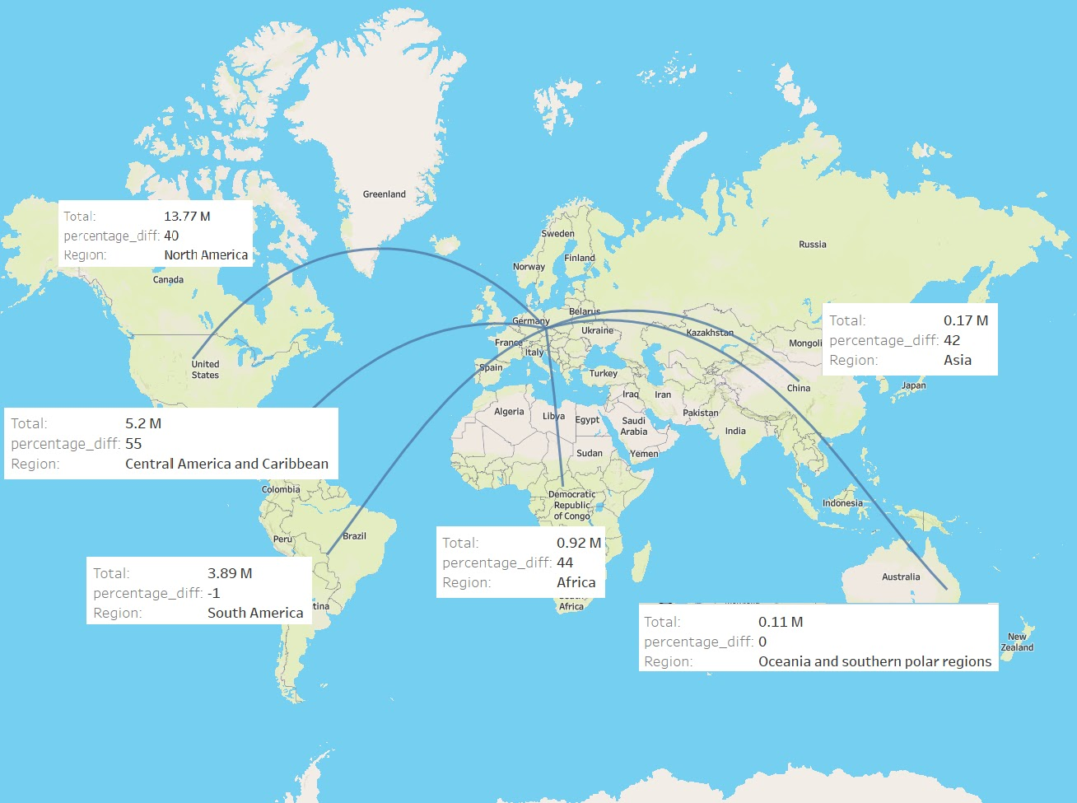

Slide 7
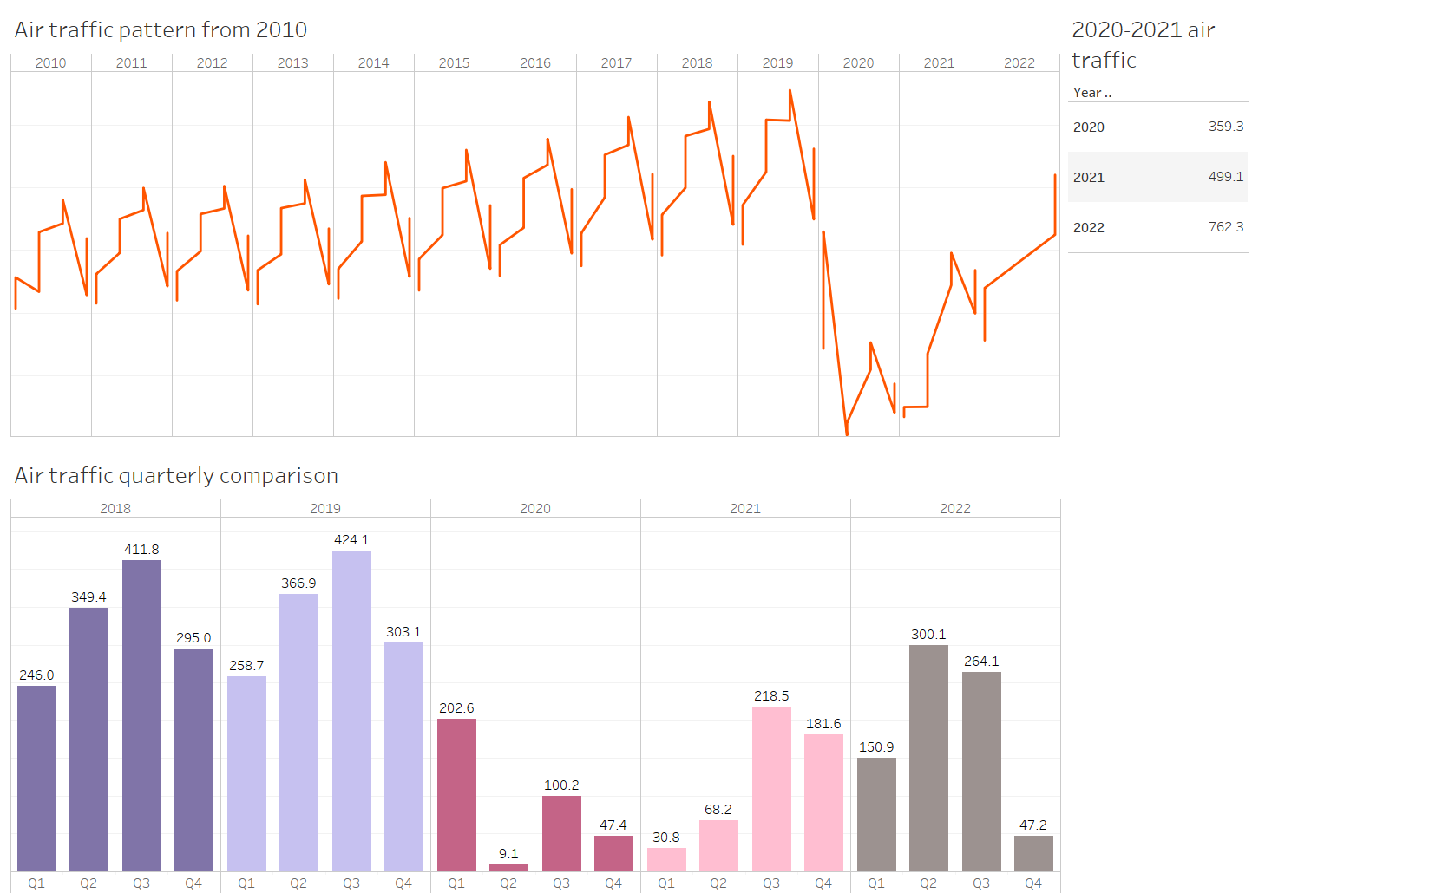

?

Slide 8
Summary
In 2021 air transportation immediately started to recover in EU, by %34
Despite the recovery in 2021, when we compared with 2019 it was still below %60
First half of 2022 (338 million) is almost same as entire 2021
When we look at the trends between Q2 and Q3, we might expect significant recovery in 2022

Slide 9
Thank you

